Slide 1


CHESS
OPENINGS
DASHBOARD

Slide 2


LICHESS
DATASET
Lichess is a online chess server where people can play chess across the globe for free. My dataset named "Chess Game Dataset (lichess)" includes 20,000 games collected from a selection of users on the site lichess.org. My dataset contains columns like Game ID, Rated, Start Time, End Time, No. Of Turns, Game Status and many more other columns.

Slide 3
OBJECTIVE
ANALYZING CHESS OPENINGS
WIN /LOSS
STATISTICS
DATA DRIVEN INSIGHTS
COMPETETIVE ADVANTAGE
PLAYER PREFRENCES
DECISION
MAKING

Slide 4


CLEANING THE DATA
The unnecessary columns have been removed and the relevant columns for visualisation such as Victory Status, Winner, White Rating, Black Rating, Moves, Time Increment, Opening Name have been kept.

Slide 5

STEPS
Changed the Number of Turns column to Number Of Moves column, performed data munging in Power Query Editor and transformed.
01
02
Used Dax Functions (SWITCH) to simplify the time format as Blitz, Rapid and Classical
Added interactive and attractive visualizations for a informative and engaging dashboard and used Decomposition Tree, Donut Charts, Slicers, Cards and Stacked Bar Chart as the visualizations.
03

Slide 6

CONCLUSION
The dataset provided valuable insights about opening preferences.
01
Analyzing opening selection by the basis of games won
02
Providing recommendations or insights for chess players based on historical data.
03

Slide 7
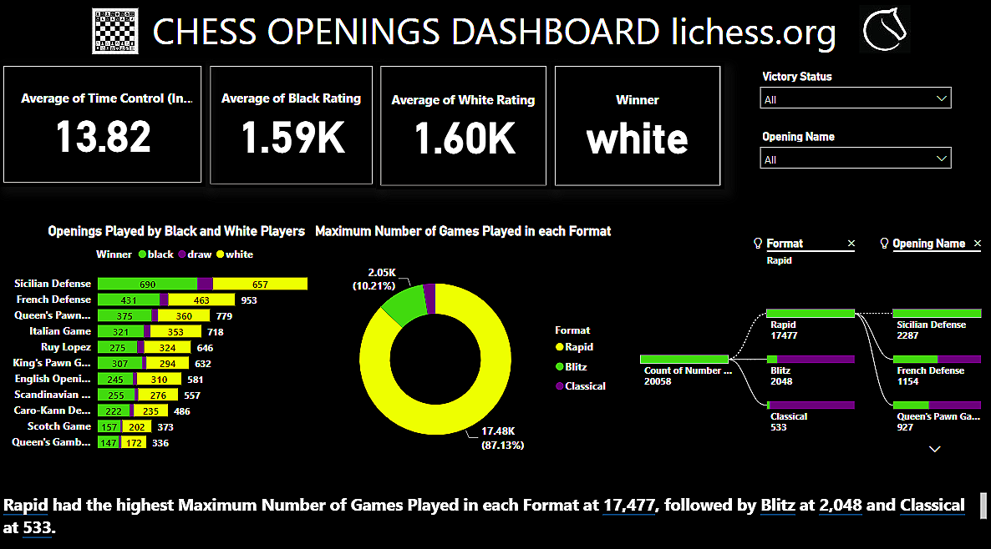

Slide 8






THANK YOU !!

